Slide 1
Chapter 5 - Identifying Variables
authored by Stephanie Fleischer © SAGE publications Ltd 2014

Slide 2
Topics covered
What is a variable?
Difference between concepts and variables
How to turn concepts into variables
Types of variables
Types of measurement scales
authored by Stephanie Fleischer © SAGE publications Ltd 2014

Slide 3
What is a variable?
An image, perception or concept that is measurable
Gender (male/female)
Variables take on different values often expressed as numbers
Age (x years, y months)
Use of measurement scales to vary the degree of precision in measurement
authored by Stephanie Fleischer © SAGE publications Ltd 2014

Slide 4
Difference between concepts and variables
Concepts cannot be measured (e.g. satisfaction has different meaning to different people)
Variables can be measured (e.g. persons weight in kg)
Convert concepts into variables using a set of indicators in order to subjectively measure (e.g. effectiveness, attitude)
authored by Stephanie Fleischer © SAGE publications Ltd 2014

Slide 5
Converting concepts into variables
How can a concept be measured? What indicators can be identified? Convert into a measurement
Concept: rich/poor
Indicators: 1. Income, 2. value of assets
Variables: 1. Total income per year, 2. Total value of a) home, b) cars, c) investments, etc.
Working definition for rich if 1. Income is > 200,000, 2. considered rich if total value of assets is >2,000,000
authored by Stephanie Fleischer © SAGE publications Ltd 2014

Slide 6
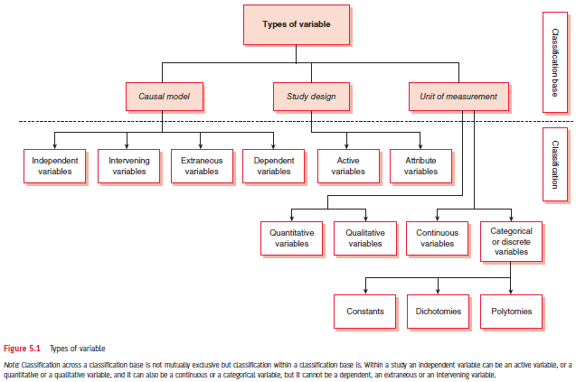
Figure 5.1 Types of variables
authored by Stephanie Fleischer © SAGE publications Ltd 2014

Slide 7
Variables from a viewpoint of causal relationships
Independent variable (bringing change in a situation)
Dependent variable (outcome or change brought by the independent variable)
Extraneous variable (several factors affecting the changes in the dependent variable)
Intervening variable (confounding variable links independent and dependent variable)
authored by Stephanie Fleischer © SAGE publications Ltd 2014

Slide 8
Variables from a viewpoint of study design
Active variables (that can be manipulated, changed or controlled in an experiment)
Attribute variables (variables that cannot be manipulated and that reflect the characteristics of a study population)
authored by Stephanie Fleischer © SAGE publications Ltd 2014

Slide 9
Variable from the viewpoint of unit measurement
Categorical variable (nominal and ordinal scales)
Constant variable (one category or value, e.g. taxi)
Dichotomous variable (two categories, e.g. yes/no)
Polytomous variable (more than two categories, e.g. religion: Christian, Muslim, Hindu, etc.)
Or Continuous data (interval and ratio scales)
Qualitative variables are like categorical variables such as gender: male/female
Or Quantitative (interval and ratio scales)
authored by Stephanie Fleischer © SAGE publications Ltd 2014

Slide 10
Type of variable
“The way a variable is measured determines the type of analysis that can be performed, the statistical procedures that can be applied to the data, the way the data can be interpreted and the finding that can be communicated.”
authored by Stephanie Fleischer © SAGE publications Ltd 2014

Slide 11
Types of measurement scales
Nominal or classificatory scale, e.g. religion: Christian, Muslim, Hindu, Jew, etc.
Ordinal or ranking scale (categories in order) e.g. socio economic status: upper/middle/low
Interval scale (has equal units of measurements with an arbitrary starting point) e.g. Temperature in Fahrenheit
Ratio scale (equal units of measurement with fixed starting point at zero) e.g. height in cm
authored by Stephanie Fleischer © SAGE publications Ltd 2014

